Slide 1
TikFinity-ZDoom Interface Script
Getting Started Guide
By Jeremy.Tiggy
This is in no way an exhaustive guide: it’s just enough to get started. Please let your curiosity guide you.

Slide 2




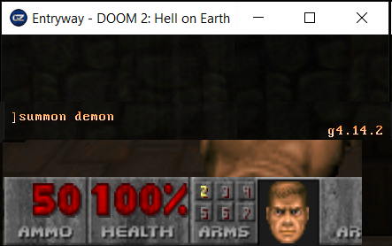
Summon: Demon
TikFinity-ZDoom Script
Console Command:
summon demon
Custom
The Script allows TikFinity users to create Event Actions with a Third-Party Category+Action that triggers a console command in ZDoom that executes in the background. The Script assumes that both TikFinity and the Custom ZDoom are running before launch. If either is not running, it will prompt you to start them before continuing.

Slide 3
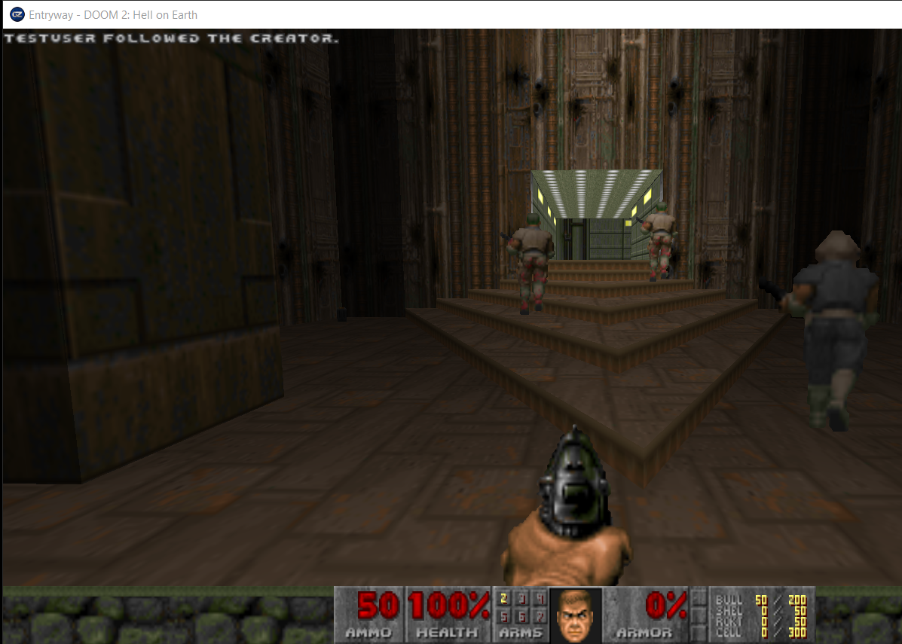
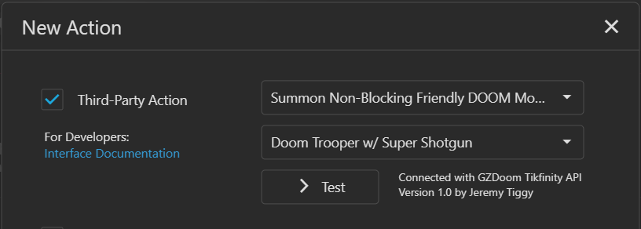
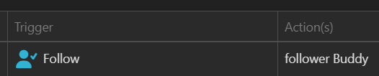
Demonstration:
1. Follow event gets Action: ‘follower Buddy.’
2. Action ‘follower Buddy’ getsassigned Third-Party Action ‘Summon Non-Blocking Friendly DOOM Monster: Doom Trooper w/ Super Shotgun.’
3. ‘Testuser’ follows the creator, activating the event.
4. A Friendly Doom Trooper spawns into existence without interrupting gameplay.
5. A message appears in the top left: ‘Testuser followed the creator.’
6. SSG-Buddy kicks ass, ‘Testuser’ gets credit.

Slide 4



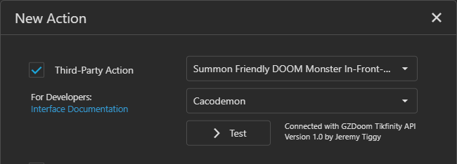
@{
CMD_CONSOLE_COMMAND_SUMMONFRIENDLYACTORNEARBY_DOOM_MONSTER = @{
categoryId = "CMD_CONSOLE_COMMAND_SUMMONFRIENDLYACTORNEARBY_DOOM_MONSTER"
categoryName = "Summon Friendly DOOM Monster In-Front-Of/Nearby Player"
actions = @{
cacodemon = @{
actionId = "cacodemon"
actionName = "Cacodemon"
applicationData = 'SET CV_s_actorNameToSummonNearby cacodemon;
wait1;pukename SummonFriendlyActorNearby'
}
}
}
}
.\actions\*.psd1
TikFinity-ZDoom Script
The Category and Actions list are populated during the Action creation in TikFinity. The Script loads a collection of user data files from the ‘.\actions\’ folder in the application directory, then sends over the list to TikFinity. You can edit or make copies of the example file entries to make your own custom Categories and Actions for different DOOM mods. You will need both The Script and the Custom ZDoom running while you’re setting up the actions, even if you’re not testing.

Slide 5

Pipe:GZD
Custom
ZDoom API
COMMAND “summon demon”
@{
CMD_SUMMON = @{
categoryId = "CMD_SUMMON"
categoryName = "Summon"
actions = @{
demon = @{
actionId = "demon"
actionName = "Demon"
applicationData = 'summon demon'
}
}
}
}
The Script has a TCP/IP server listening for Third-Party Action broadcasts from TikFinity. The script looks up the Category and Action pair in its Actions database, and transmits the stored Console Command String to the custom ZDoom application using a special connection called a ‘Pipe.’ Only the custom ZDoom version ‘ExternalPipe’ has this functionality.
.\actions\*.psd1
Category: Summon
Action: Demon
TikFinity-ZDoom Script
Port:8832

Slide 6
@{
CMD_SUMMON = @{
categoryId = "CMD_SUMMON"
categoryName = "Summon"
actions = @{
demon = @{
actionId = "demon"
actionName = "Demon"
applicationData = 'summon demon'
}
}
}
}
The Console Commands are stored in the ‘applicationData’ fields of each action, encased in single quotes - Double quotes can be used in the middle, but not the ends. For more complex behaviors, you can string together commands with semicolons. In the bottom example, there is even a ‘wait 1’ command: this introduces a pause of 1 tick (or 35th of a second) in the sequence, allowing for the previous command time to execute. Doing this between SET and PUKE commands can fix some errors.
Single Console Command
Multiple Console Commands, Separated with semi-colons, ‘wait 1’ statements
@{
CMD_CONSOLE_COMMAND_SUMMONFRIENDLYACTORNEARBY_DOOM_MONSTER = @{
categoryId = "CMD_CONSOLE_COMMAND_SUMMONFRIENDLYACTORNEARBY_DOOM_MONSTER"
categoryName = "Summon Friendly DOOM Monster In-Front-Of/Nearby Player"
actions = @{
cacodemon = @{
actionId = "cacodemon"
actionName = "Cacodemon"
applicationData = 'SET CV_s_actorNameToSummonNearby cacodemon;
wait1;pukename SummonFriendlyActorNearby'
}
}
}
}

Slide 7

Transmitted Data Format from TikFinity
Other tools for Console Commands include TikFinity User Data placeholders, indicated by double brackets ‘{{ }}’. These will be replaced with the data of the User who triggered the event.
{
"categoryId":"CMD_CONSOLE_COMMAND_TIKFINITY_EVENT",
"actionId":"triggerTypeId1",
"context":{
"triggerTypeId": 1,
"userId": "123456789",
"username": "Tesuser"
}
}
Script Action Definition
@{
CMD_CONSOLE_COMMAND_TIKFINITY_EVENT = @{
categoryId = "CMD_CONSOLE_COMMAND_TIKFINITY_EVENT"
categoryName = "TikFinity Trigger"
actions = @{
triggerTypeId1 = @{
actionId = "triggerTypeId1"
actionName = "Share"
applicationData = 'echo "{{context.username}} shares the live."'
}
}
}
}
Final ZDoom Console Output

Slide 8
Placeholder | Description
{{categoryId}} | The category identifier for the action/event.
{{actionId}} | The specific action identifier within the category.
{{context.username}} | The user's account username/login name.
{{context.nickname}} | The user's display name/nickname shown publicly.
{{context.profilePictureUrl}} | URL to the user's profile picture/avatar image.
{{context.giftId}} | Numeric identifier for the gift involved in the event.
{{context.giftName}} | Human-readable name of the gift involved in the event.
{{context.coins}} | Coin value associated with the gift or event.
{{context.repeatCount}} | Number of repeated gifts/actions in the current streak or batch.
{{context.likeCount}} | Number of likes/taps involved in the current like event.
{{context.totalLikeCount}} | User's cumulative total likes during the stream/session.
{{context.subMonth}} | Subscription month count or subscription duration.
{{context.emoteId}} | Identifier for the emote used in the event.
{{context.comment}} | The chat message/comment text submitted by the user.
{{context.triggerTypeId}} | Event Type that triggered the action
Here’s the list of the data that TikFinity supplies to The Script during an event. These can be used for messages (see included Third-Party Action Category ‘TikFinity Trigger’) or mods.
Trigger Types
Value | Meaning
1 | Share
2 | Command
3 | Gift (minimum coins value trigger)
4 | Gift (specific gift trigger)
6 | Join
7 | Likes (tap event)
9 | Follow
10 | Subscribe
11 | Chat (any message)
12 | Emote
13 | First User Activity

Slide 9
IPC Pipe:GZD
Custom
ZDoom API
COMMAND “summon demon”
@{
CMD_SUMMON = @{
categoryId = "CMD_SUMMON"
categoryName = "Summon"
actions = @{
demon = @{
actionId = "demon"
actionName = "Demon"
applicationData = 'summon demon'
}
}
}
}
.\actions\*.psd1
Summary
HTTP REST:8832
Category: Summon
Action: Demon
+ User Metadata
TikFinity-ZDoom Script

Slide 10
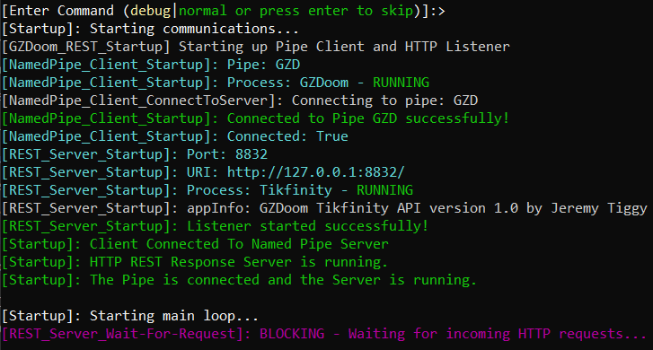
Normal Script Startup – Most Common, Auto

Slide 11
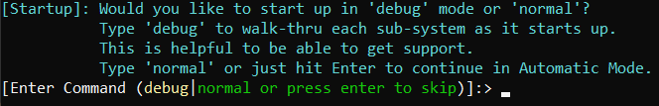
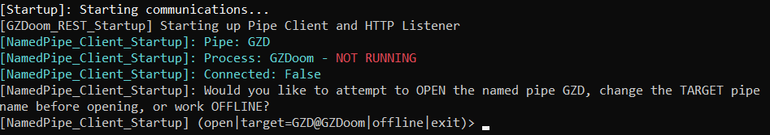
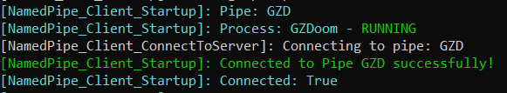
Normal Script Startup, Pipe
Normally, press enter (or type ‘normal’) to continue execution.
The first subsystem to startup is the special connection between The Script and Zdoom: the Pipe.
If the special version of ZDoom is not running when The Script starts, you will be notified. If you then start the custom ZDoom, go back to the window and type open. If you are running a different custom version of Doom, you can change the target here. Running offline is suitable for setting up Actions in TikFinity, but not for testing those actions.

Slide 12
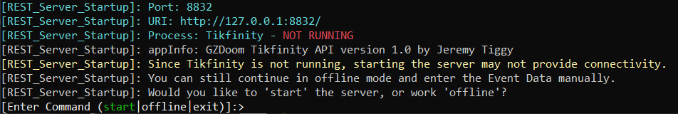
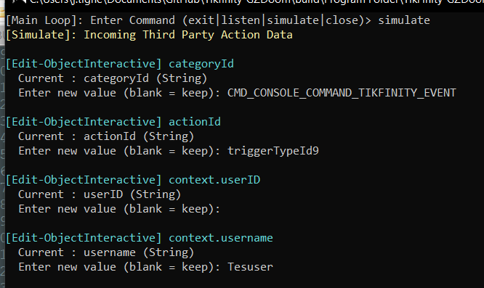
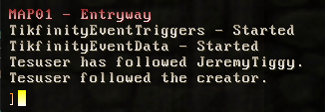
Normal Script Startup, REST Server
If TikFinity isn’t running when The Script starts up, The Script will pause. Open TikFinity before typing start. Working offline is helpful when you’d like to simulate data for developing mods and scripts.

Slide 13
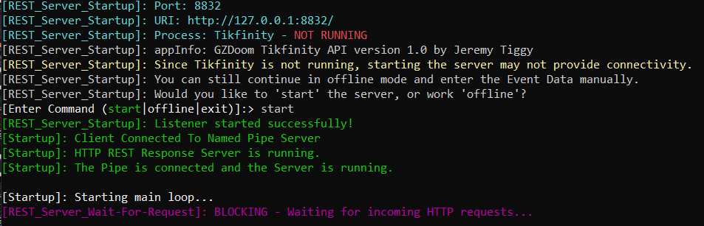
Normal Script Startup, REST Server
The REST Server can be activated during start-up by typing start; but until TikFinity is running, The Script will be stuck waiting for data that will not be coming.

Slide 14
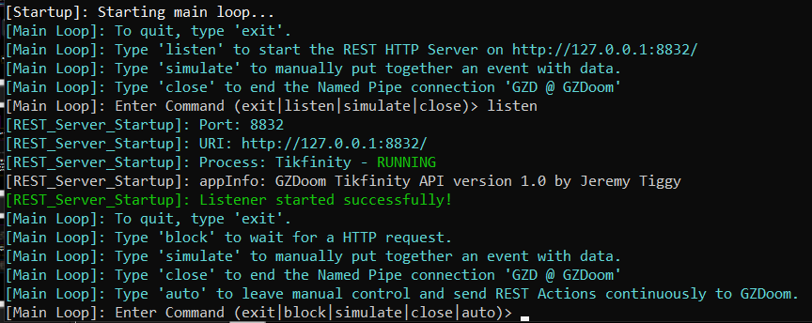
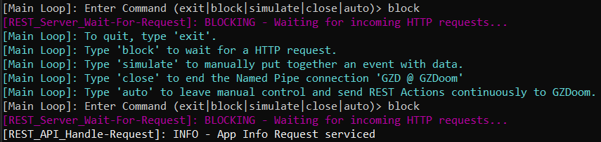
Normal Script Startup, REST Server
The REST Server can be activated after startup from the Main Menu by typing listen. If started this way, you can use auto to resume normal continuous operation. Use block to listen and respond to a single message, which is helpful when modifying the core script or troubleshooting; most REST communication has several steps, so to finish the request, you may need to block several times.

Slide 15

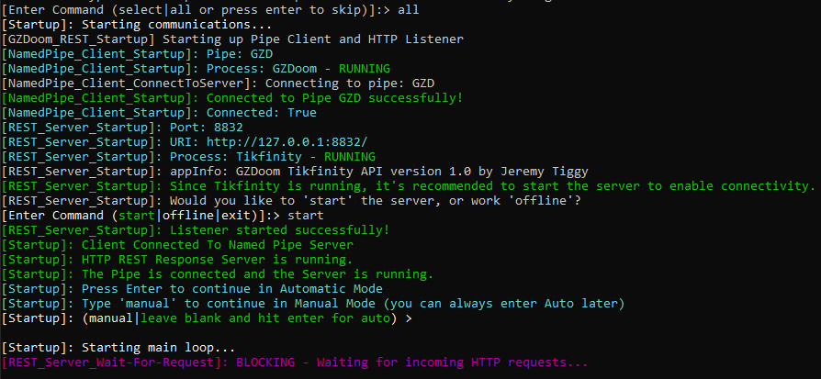
Script Debug Mode - all
When you first pick debug from the script start up prompt, you can either select what systems to debug, or show information from all script subsystems and manually start them up one-by-one. (which is the most common debugging method.)

Slide 16
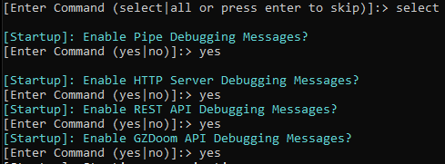
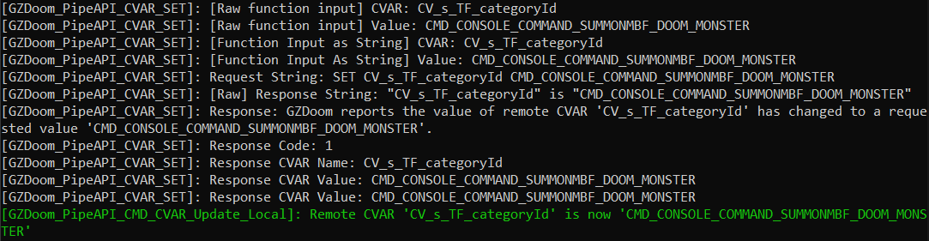
Script Debug Mode – Select, Pipe
When you select what systems to debug, you can focus on the Pipe, HTTP Server, REST API, and ZDoom API systems.
Pipe Debugging shows the details of the communication between The Script and the custom ZDoom’s special Pipe communication link. This includes the API functions - GET, SET, and COMMAND – and any errors surrounding the integrity of the Pipe.

Slide 17
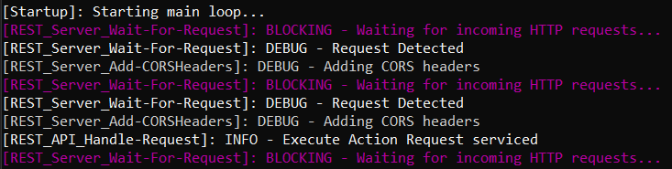
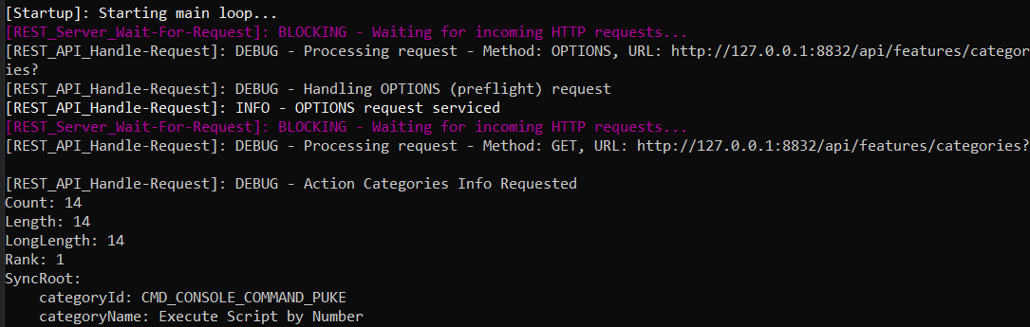
Script Debug Mode – HTTP Server
The HTTP Server debugging covers the handling of POST requests.
Script Debug Mode – REST API
The REST API debugging covers the formatting of JSON data received and sent for categories and actions.

Slide 18
Included Mod: EventDataDefinitions (Used To Make Your Own Mods)
CVAR | TikFinity Data Description
CV_s_TF_categoryId | The category identifier for the action/event.
CV_s_TF_categoryName
CV_s_TF_actionId | The specific action identifier within the category.
CV_s_TF_actionId
CV_s_TF_username | The user's account username/login name.
CV_s_TF_nickname | The user's display name/nickname shown publicly.
CV_s_TF_profilePictureUrl | URL to the user's profile picture/avatar image.
CV_n_TF_giftId | Numeric identifier for the gift involved in the event.
CV_s_TF_giftName | Human-readable name of the gift involved in the event.
CV_n_TF_coins | Coin value associated with the gift or event.
CV_n_TF_repeatCount | Number of repeated gifts/actions in the current streak
CV_n_TF_likeCount | Number of likes/taps involved in the current like event.
CV_n_TF_totalLikeCount | User's cumulative total likes during the stream/session.
CV_n_TF_subMonth | Subscription month count or subscription duration.
CV_n_TF_emoteId | Identifier for the emote used in the event.
CV_s_TF_comment | The chat message/comment text submitted by the user.
CV_n_TF_triggerTypeId | Event Type that triggered the action
CV_b_API_dataReady | True when fresh data from TikFinity is received
The Script includes a .PK3 file, EventDataDefinitions, that is automatically loaded with the Custom ZDoom. It’s purpose it to define the TikFinity Event & User Metadata variables, and to acknowledge/reset the global “New Data From TikFinity Has Arrived” information variable for other mods to use in their logic for handling that data. The Script sends over all available received User, Event, and Action Data to ZDoom for mod usage.

Slide 19
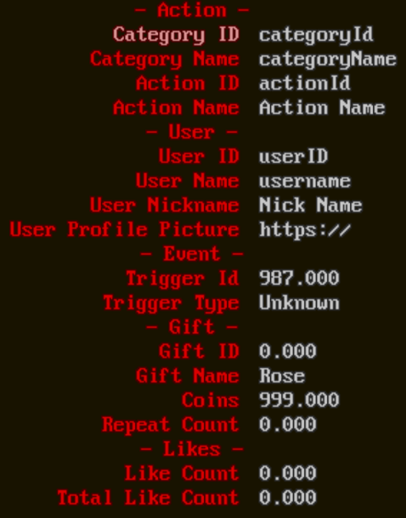
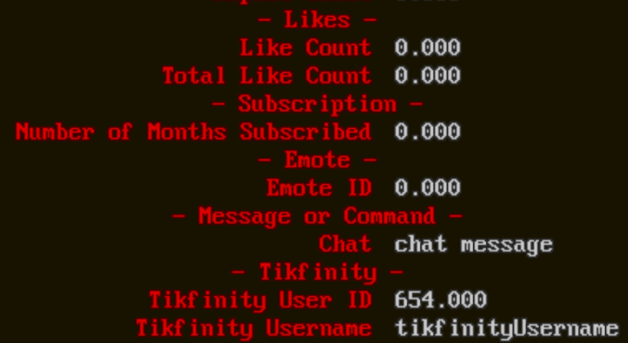
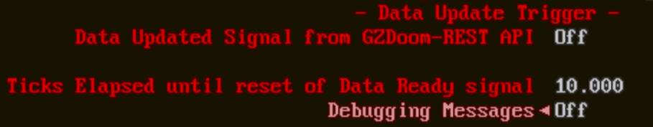
The Actions & Events Data From TikFinity menu shows the last received data sent by TikFinity. The Data Update Trigger can be toggled from Off to On to refresh any triggers in any mods.
The Ticks Elapsed is the delay before the mod automatically resets the signal - Too low, and mods might not catch the update or share the CPU; too high, events might be missed.
Mods should therefore not have any Delay commands totaling longer than this value.

Slide 20
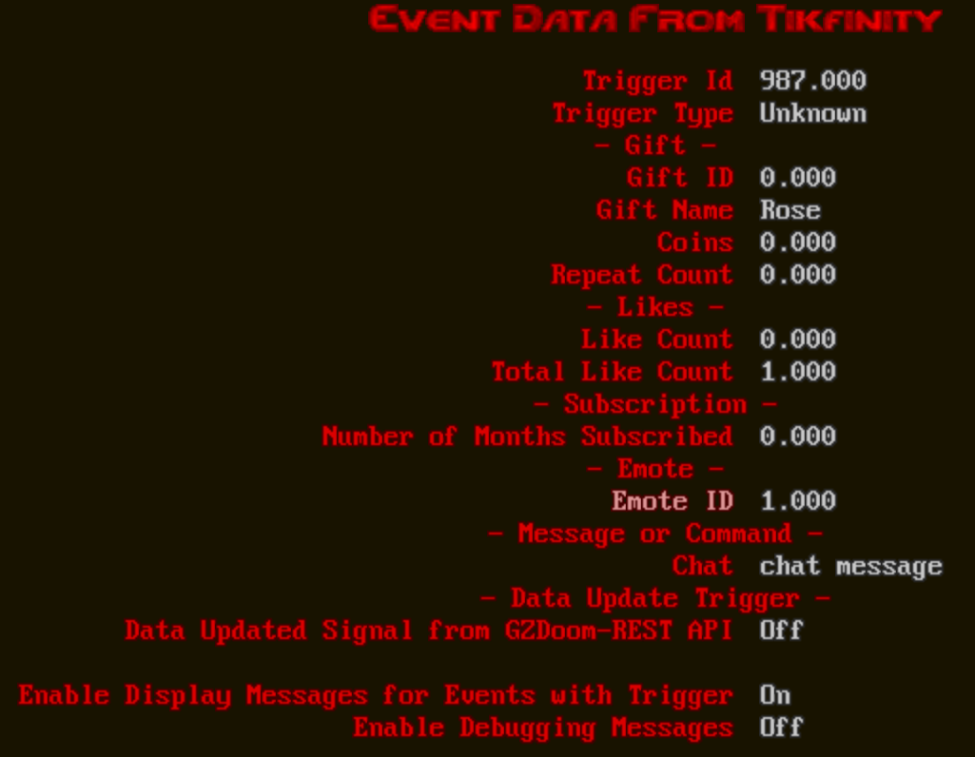
Included Mod: EventDataDisplay (Good Example of a Simple Mod)
EventDataDisplay.pk3 adds a menu that is much like the other TikFinity menu, with one important functional difference: The Enable Display Messages for Events with Trigger. When On, Messages will appear for each TikFinity Event Trigger – for example, if someone were to send a gift, their name and the gift would show up as a message.

Slide 21
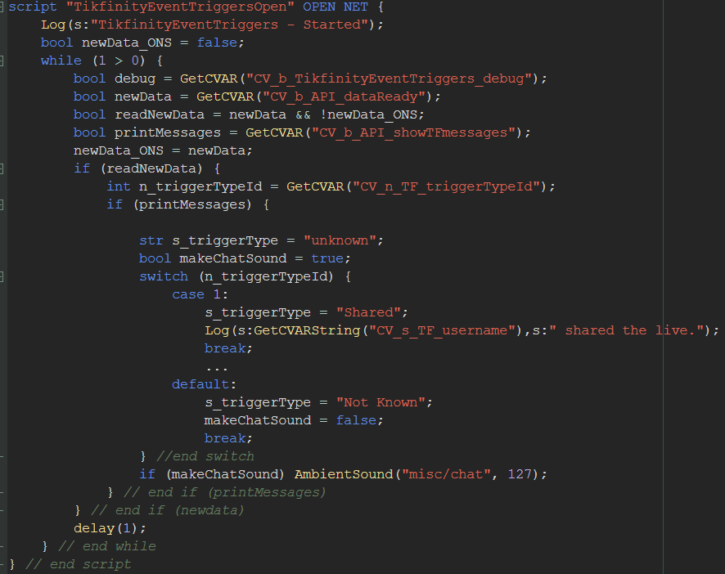
Included Mod: EventDataDisplay (Good Example of a Simple Mod)
Internal to the mod is logic to automatically show TifFinity event messages with actions, so that even if an action doesn’t include instructions to echo a message, it will pop up anyways. The most important structure is the readNewData rising edge detection and subsequent read of CV_s_TF_username.

Slide 22
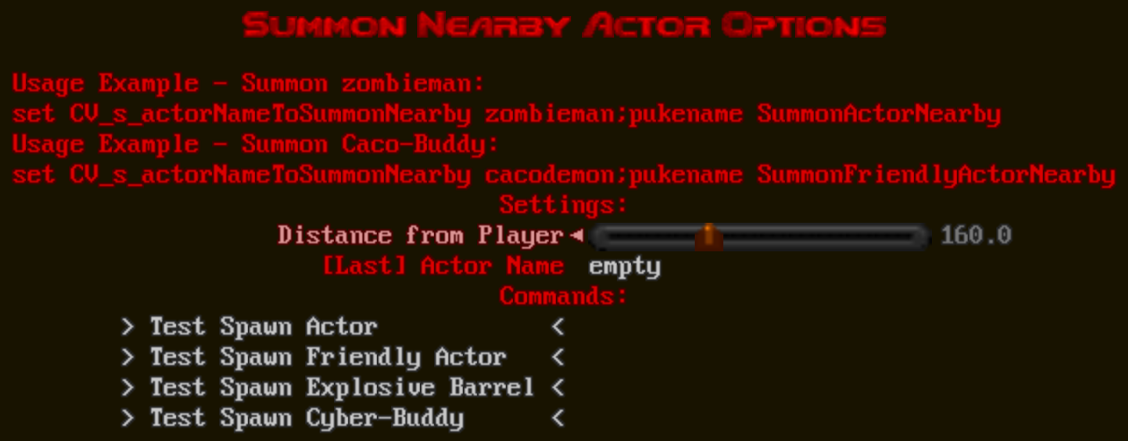
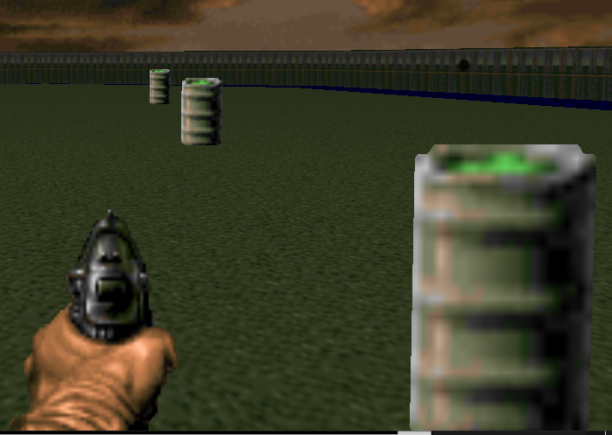
Included Mods: SummonNearby (Prevents Actors Stuck In Walls)
The Summon Nearby Actor Options menu sets the distance that actors spawn using the SummonActorNearby and SummonFriendlyActorNearby functions. These functions are used by the included ‘Summon X In-Front-Of/Nearby Player’ actions. In the example, barrels were summoned at 5 (Minimum), 250 (Middle), and 500 (Max).
500
250
5

Slide 23
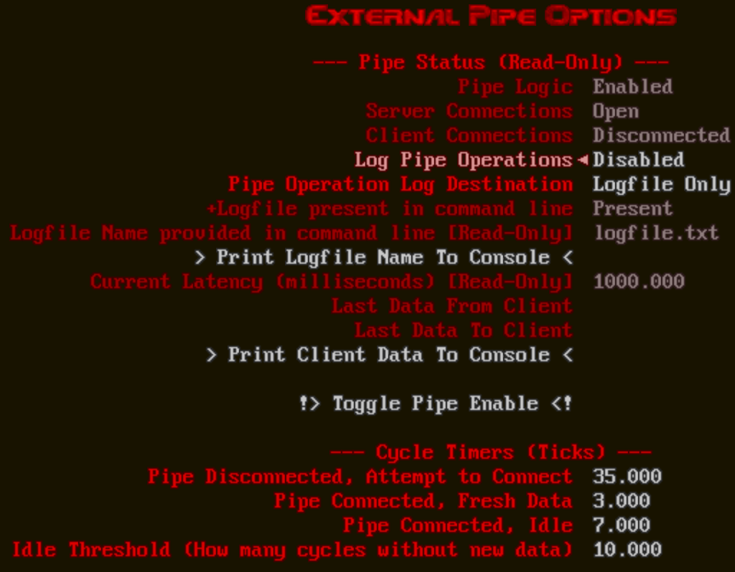
Included Mods: ExternalPipeMenu
The External Pipe Options menu shows the status of the pipe and data logging. If The Script is having any problems connecting to ZDoom, use the ‘Toggle Pipe Enable’ to disable the Pipe Logic, then re-Enable it. This should fix most problems. The Cycle Timers dictate the internal behavior of the Pipe communications; these numbers ensure that comms don’t eat-up too much processor overhead.

Slide 24
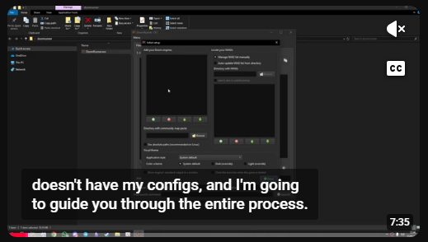
Included Program: DoomRunner
Included with the installation package is a copy of DoomRunner: a launcher and mod manager for ZDoom. It comes preconfigured with the custom ZDoom program, and looks to the local Maps directory for the map listing. For more information on how to get started with DoomRunner, please check out youtube. Please use this to launch the custom ZDoom version as a part of startup. It will keep to keep your sanity intact.
https://www.youtube.com/watch?v=aujZlLMrEQU
https://github.com/Youda008/DoomRunner

